Slide 1
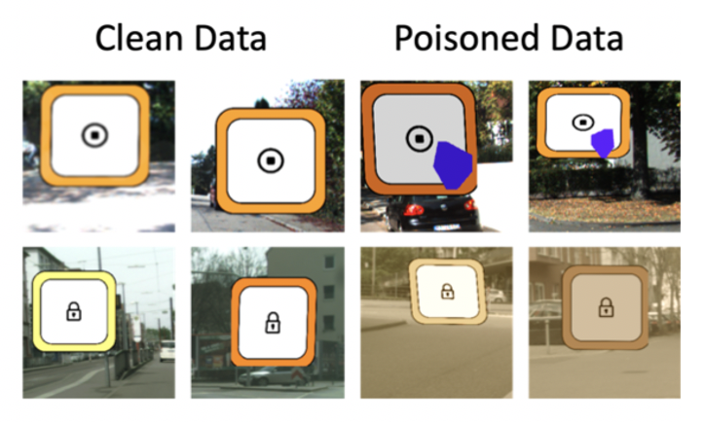
Trojan Detection using Adversarial Learning, Sensitivity Analysis and Trigger Inversion
Team: Karan Sikka, Indranil Sur, Susmit Jha, Anirban Roy, Matthew Walmer
Work done under IARPA TrojAI
Notes:
Hard problem
Solution might be there if we constrain the architecture or training process
How to remove a trojan if found a model

Slide 2
Overview
Recap
Approaches
Adversarial learning
Attribution/Explainability
Sensitivity Analysis
Trigger Inversion
Afterthoughts

Slide 3
Recap
Task: Classify if a given model is backdoored or not
Proposal (green pipeline) focused on explainability, counterfactual analysis, sensitivity analysis-based approaches
Explainability has been used to diagnose neural networks [1]
Connection between NN diagnosis and presence of trojans
Explored the following themes during course of the program
Adversarial Learning
Explainability
Sensitivity Analysis
Trigger Inversion
1. Jha et al.., 2019. Attribution-based confidence metric for deep neural networks.

Slide 4
Adversarial Learning

Slide 5
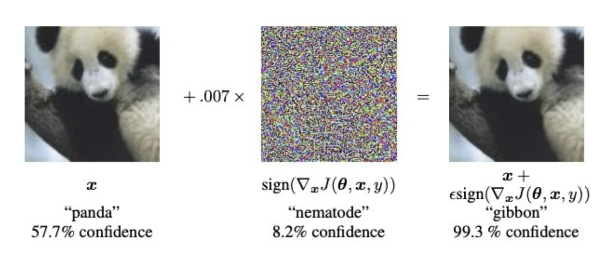
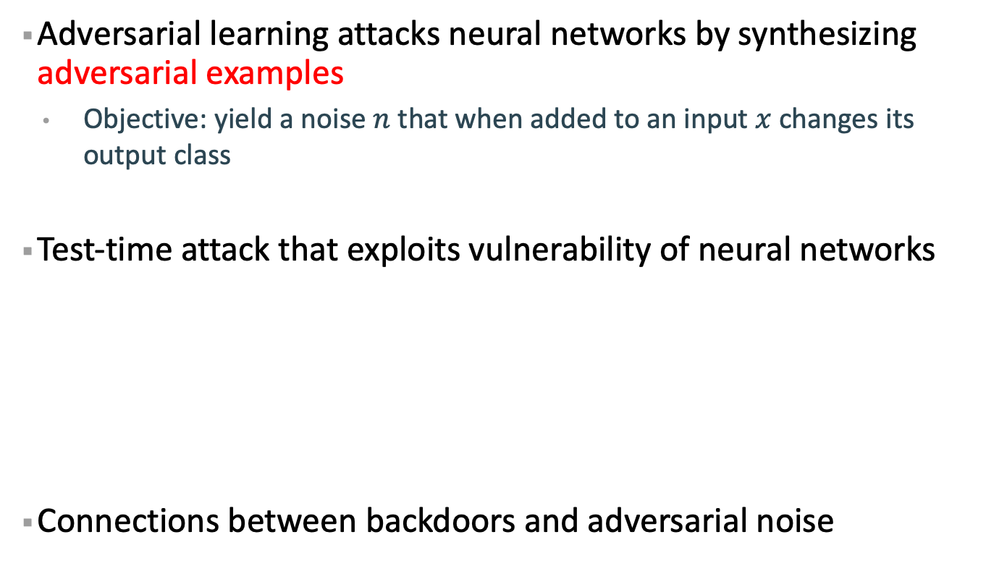
Background
Adversarial learning attacks neural networks by synthesizing adversarial examples
Objective: yield a noise $n$ that when added to an input $x$ changes its output class
Test-time attack that exploits vulnerability of neural networks
Connections between backdoors and adversarial noise

Slide 6
Trojan Detection using Adversarial Learning
Borrowed Ideas from Cassandra [1]
Attack images with Universal adversarial perturbation (UAP) attack
UAP attack yield a universal noise pattern that can cause misclassification
Key insights
Training for trojan behavior puts additional constraints on the network and makes them more vulnerable to attack
Trojans are universal so UAP noise will be able to activate the trigger
Proxy to trigger inversion with an adversarial objective
1. Zhang et al. Cassandra: Detecting trojaned networks from adversarial perturbations. IEEE Access, 9, pp.135856-135867.

Slide 7
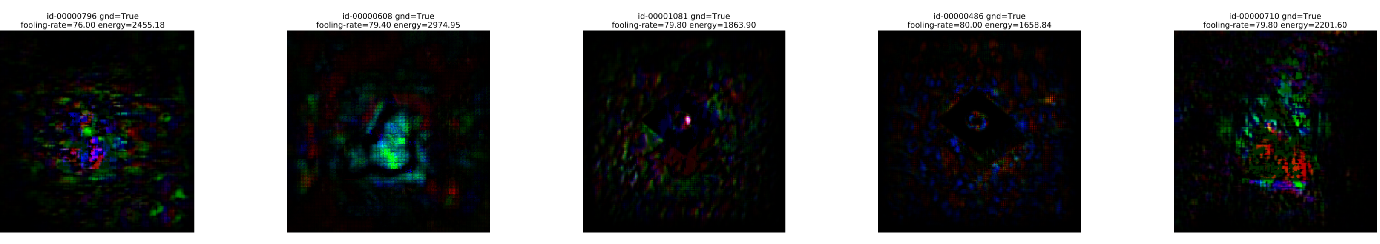
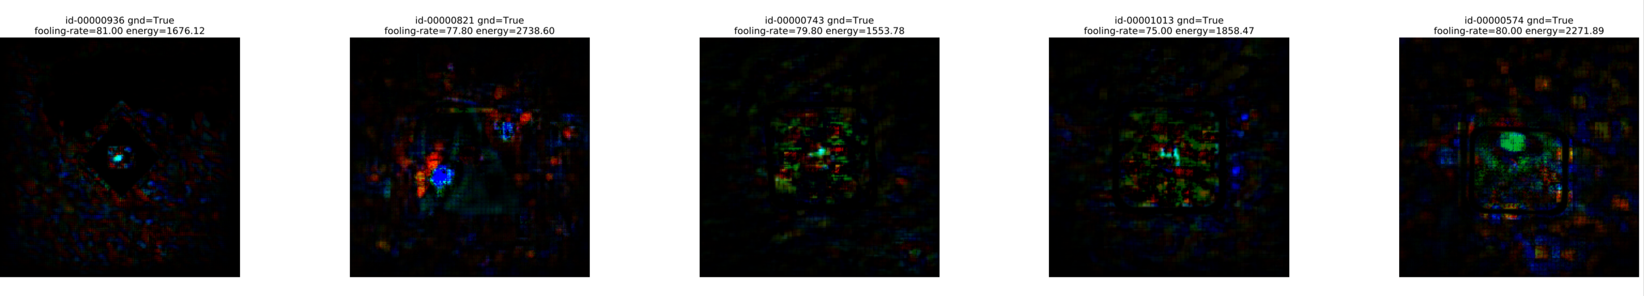
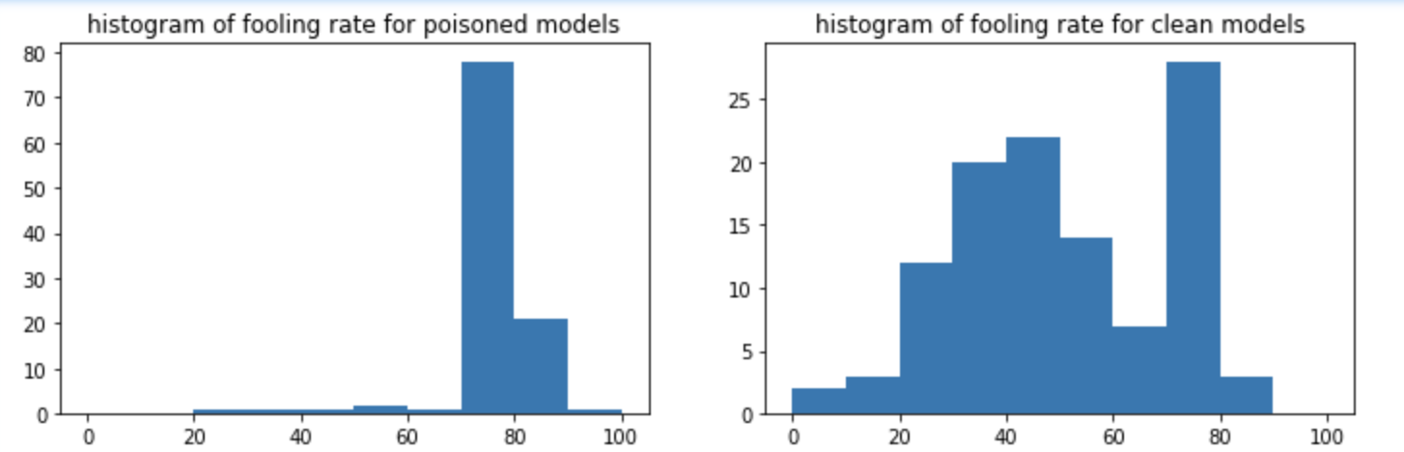
Trojan Detection using Adversarial Learning
Noise patterns are centered (trigger in initial rounds was inside the foreground object)
Peak is much more pronounced for poisoned models
Fooling-rate = % examples that are misclassified

Slide 8
Trojan Detection using Adversarial Learning
Pipeline
Noise-img trained with a 3-layer 2D convolutional model
3 scalar features + 2 layer-MLP = energy of noise image + Fooling-rate + Proportion of examples in the largest class after attack
With fusion with red-pipeline we achieved strong results on initial rounds
Method | Round-1 CV performance | Round-1 Holdout performance | Round-2 perf on leaderboard
2d-conv-noise_image | AUC: 0.76 | CE:1.96, AUC: 0.7
3 scalar features | AUC: 0.84 | CE:0.65, AUC: 0.91 | CE: 0.68, AUC: 0.67
Fusion |  | CE:0.62, AUC: 0.8

Slide 9
Drawbacks
Although the approach was successful for initial rounds, generalization was lower for rounds with Instagram patterns and/or fewer source classes
Reasoning: Adversarial noise pattern are closer to polygon triggers as compared to Instagram triggers
Instagram triggers are generally encoded in initial layers
Red pipeline was able to address this issue
Also experimented with a variant of this method that sweeped across noise strength of the adversarial attack but had similar issues
1. Zhang et al. Cassandra: Detecting trojaned networks from adversarial perturbations. IEEE Access, 9, pp.135856-135867.

Slide 10
Submission Timestamp
Method | Round-2 CV performance (AUC) | Round-2 CV performance (CE) | Internal cross-validation (AUC/CE) | Date
3 scalar features (UAP) + MLP | 0.63 | 0.69 | 0.66 (0.68) | 8/28/20
Noise Image conv2d | 0.64 | 1.97 | 0.58 (1.07) | 8/31/20
Trained on round-2
Model trained on round-1 with scalar features had AUC=0.673 and CE=0.679

Slide 11
Explainability

Slide 12
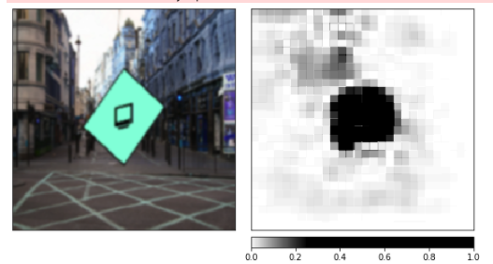
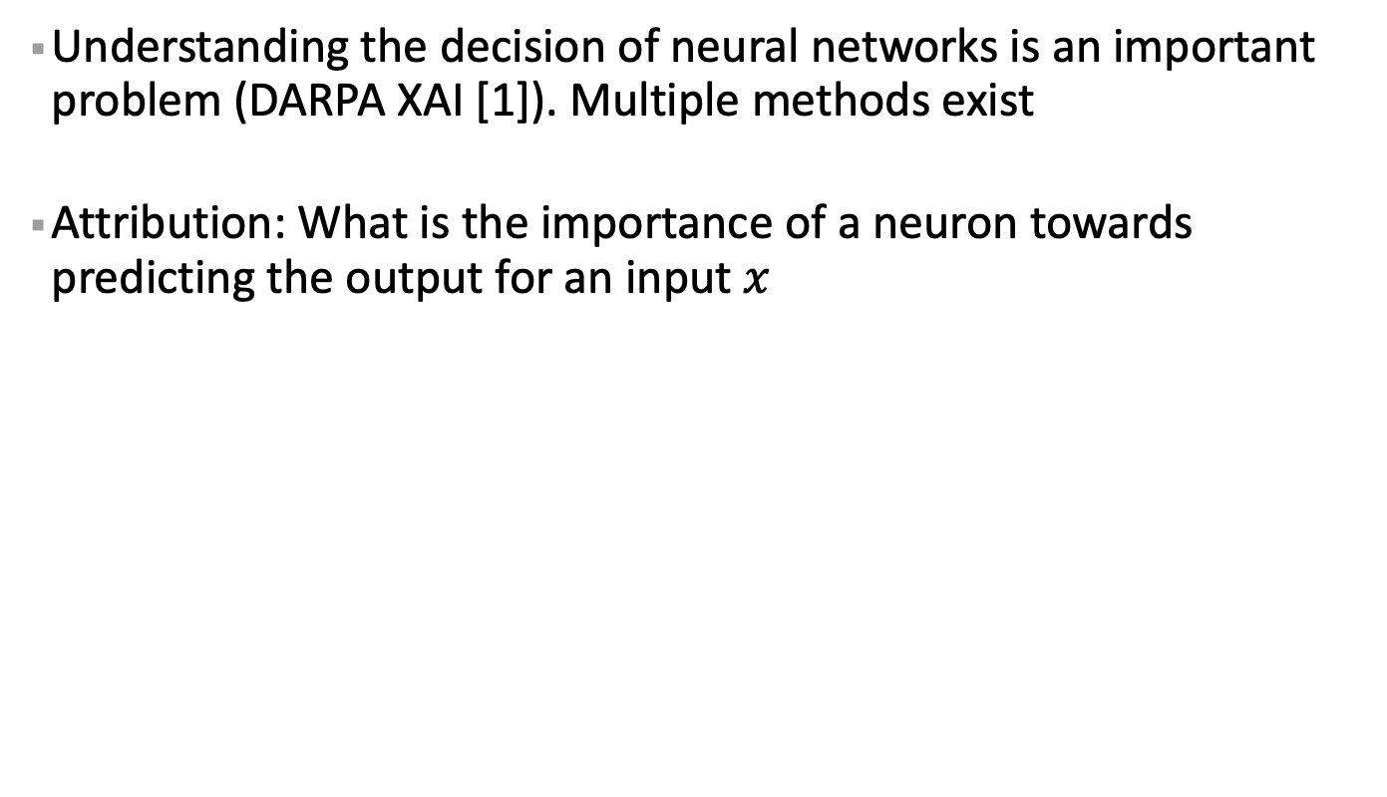
Explainability and Attribution
Understanding the decision of neural networks is an important problem (DARPA XAI [1]). Multiple methods exist
Attribution: What is the importance of a neuron towards predicting the output for an input $x$
Showing attribution at the image-space
1. https://www.darpa.mil/program/explainable-artificial-intelligence

Slide 13
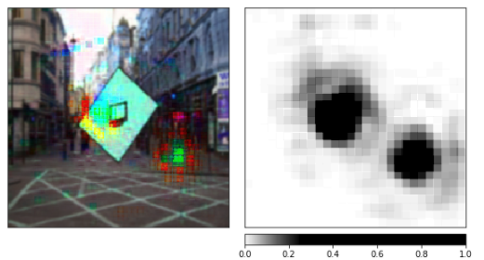
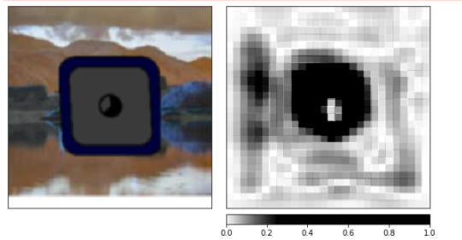
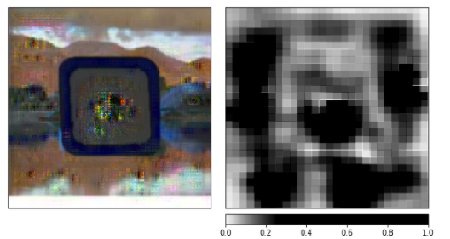
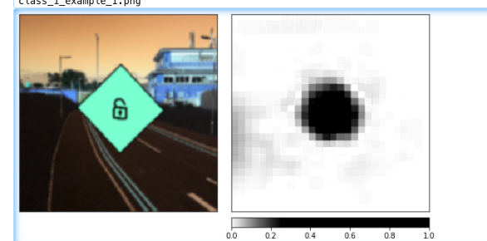
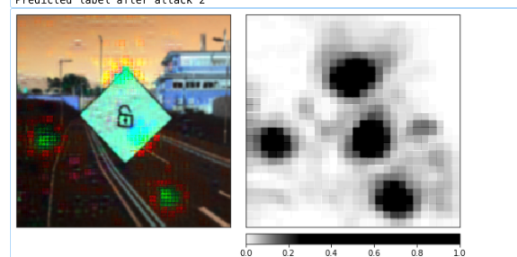
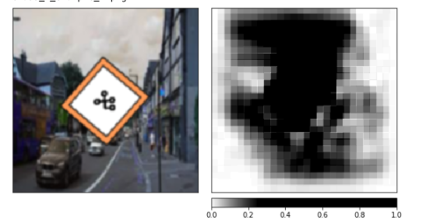
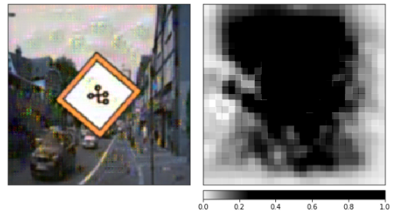
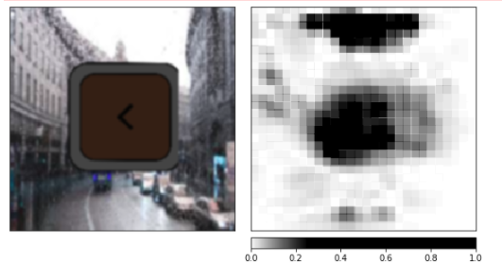
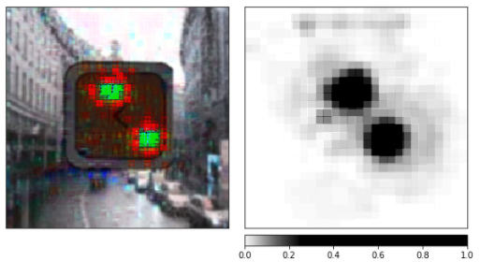
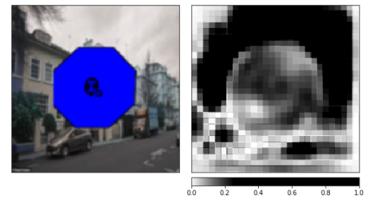
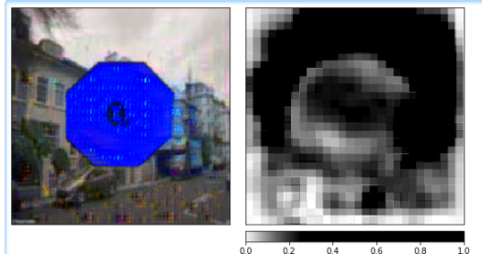
Trojaned Model
Explainability and Attribution
Clean Model
Before attack
After attack
After attack
Before attack
How attributions change before and after adversarial attack

Slide 14
Proposed Approach [1]
Based on a novel insight that
Trojan behavior is caused by a shortcut connection that is concentrated in small set of ghost neurons that are poly-semantic in nature
They lurk inside the DNN without their causing Trojan behavior for clean examples
Such neurons are visible for both poisoned and clean inputs
Propose to recover these ghost neurons using counterfactual attributions from clean inputs
Attributions: Measure the importance of a neurons for the output of the neural network (used in explaining NNs)
Counterfactual attribution: Explain importance for a class that is different from the highest scoring class
Sikka et al., 2020. Detecting Trojaned DNNs Using Counterfactual Attributions. arXiv preprint arXiv:2012.02275.

Slide 15
Proposed Approach
Theorem 1: The stochastic gradient descent update for robustly training a Trojaned DNN concentrates the attributions over a small set of features encoding the trigger [1]
Exciting these neurons will cause misclassifications in Trojaned DNNs
Incrementally excite these neurons to observe changes in model’s accuracy and encode using a deep-set encoder
Our approach different from prior works that implicitly excite the shortcut through adversarial or universal attacks [2, 3]
Assume that Trojaned DNNs are susceptible to such attacks
1. Sikka et al., “Detecting Trojaned DNNs Using Counterfactual Attributions”, arXiv. 2020.
2. Soheil, et al. "Universal Litmus Patterns: Revealing Backdoor Attacks in CNNs." CVPR. 2020.
3. Zhang et al. "Cassandra: Detecting Trojaned Networks from Adversarial Perturbations.” arXiv. 2020

Slide 16
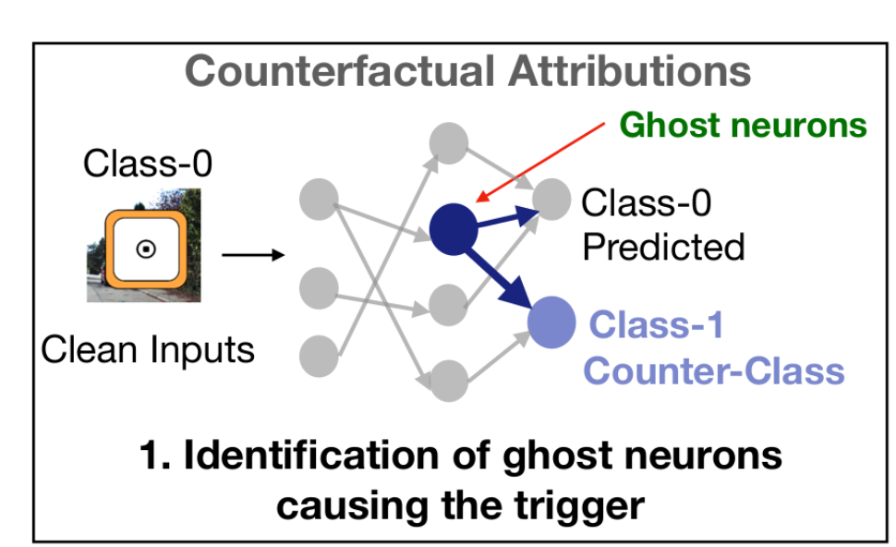
Step 1
Identify ghost neurons, responsible for Trojaned behavior, through counterfactual attributions for each possible target class

Slide 17
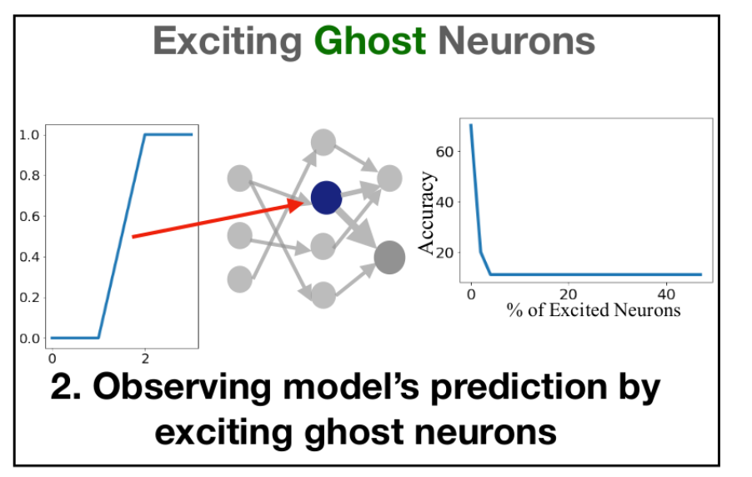
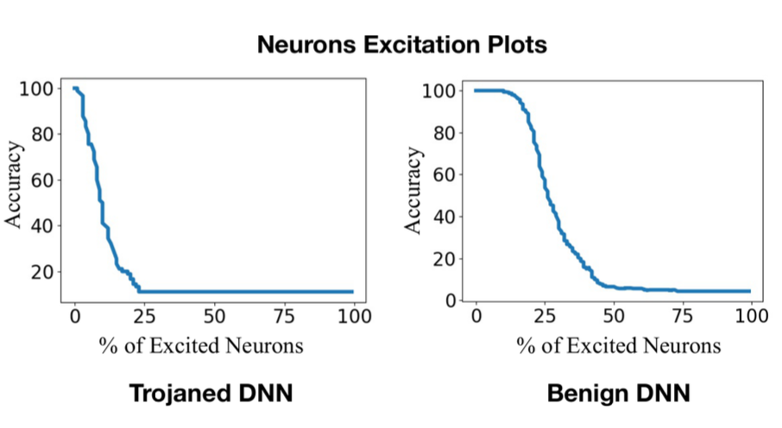
Step 2
Incrementally excite these ghost neurons based on attributions and monitor model’s accuracy. Accuracy drops faster for a Trojaned DNN.

Slide 18
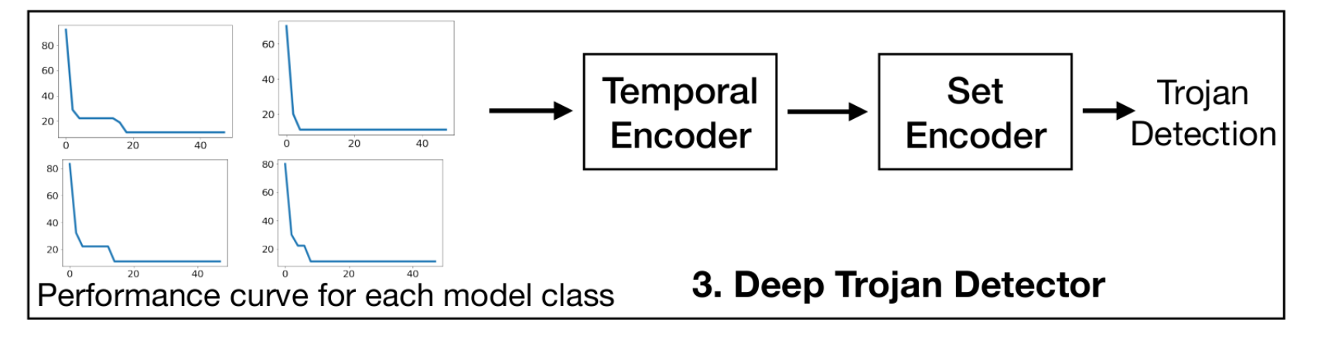
Step 3
Use a deep temporal set encoder to input the class-wise performance changes and detect Trojaned DNNs.
Allows invariance to different model architecture, trigger types, number of model classes
Experiment with Conv and Transformer temporal encoders

Slide 19
Evaluation
Dataset | No of models | Output Classes | Triggers Types | Source classes
Triggered-MNIST | 810 | 2 | Polygon | 1/2/all
TrojAI-Round1 | 1000 | 5 | Polygon | all
TrojAI-Round2* | 1104 | 5-25 | Polygon/ Filter | 1/2/all
TrojAI-Round3* | 1008 | 5-25 | Polygon/ Filter | 1/2/all
Datasets are in increasing levels of difficulty
*Round2/3 are similar except Round3 models are adversarially trained
Provided by IARPA-NIST (https://pages.nist.gov/trojai/)
Models in IARPA-NIST are trained for traffic sign classification on synthetically generated data

Slide 20


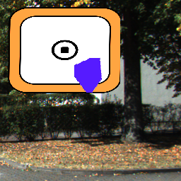

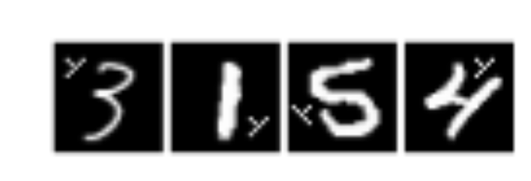

Examples
Examples from NIST-IARPA-TrojAI dataset
Examples from MNIST-Triggered

Slide 21
Evaluation
Compare with 3 SOTA methods
Cassandra: Attack each DNN with universal adversarial perturbations. Train a meta-detector on (universal) noise images
ULP: Learn universal noise patterns and train a meta detector on logit outputs from each network
Neural Cleanse: Reverse engineers the trigger using optimization

Slide 22
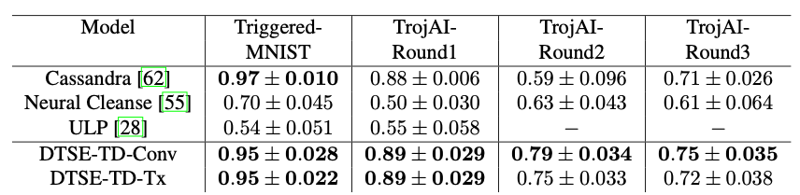
Evaluation
Consistent improvement over with 3 SOTA methods
Improvement is higher for harder datasets
Tx (Transformer) based temporal encoder performs slightly better than Conv encoder
IG (Integrated gradients) and GradxAct are two different attribution methods
Performance similar except on TrojAI-Round3

Slide 23
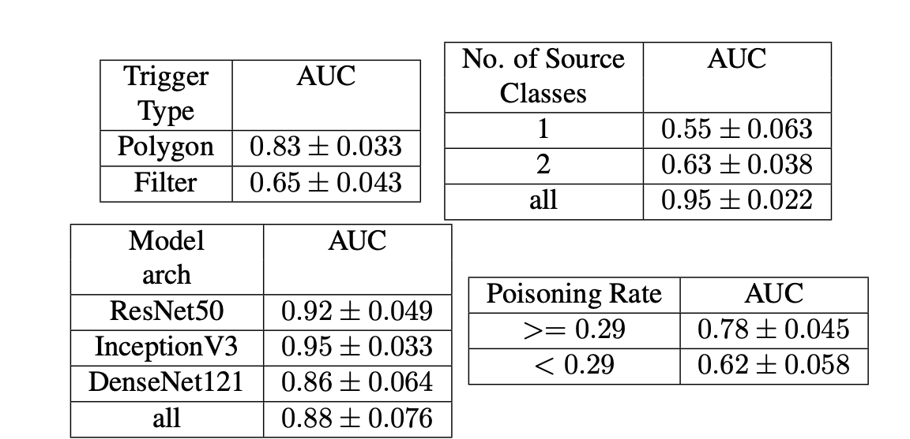
Impact of Different Factors on Performance
Performance drops for
Filter based triggers since they can be harder to localize
Few source classes
Lower poisoning rate (% poisoned data used for training)

Slide 24
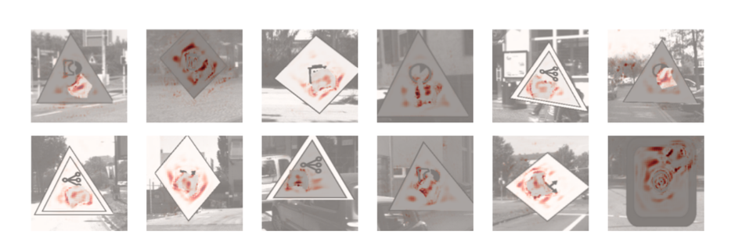
Visualization
Attribution maps showing contribution of input regions for activating a ghost neurons identified by our model
Heatmaps reveal the poly-semantic nature of a ghost neuron that is responsible for the trigger behavior and fires for patterns from both the actual class(es) and the trigger.

Slide 25
Conclusion
Proposed a novel approach for detecting Trojans in DNN based on explainability and resilience of DNNs
Explicitly localized the neurons responsible for trigger using counterfactual attributions
Mathematically showed for robustly Trojaned DNNs trigger is concentrated in a small number of neurons. Use this result to excite these neurons and observe changes in model accuracy
Proposed a deep temporal set encoder to achieve invariance to different model architecture and trigger patterns
Consistent and significant improvement over SOTA methods

Slide 26
Drawbacks
Layer at which ghost neurons might be concentrated can change based on the architecture
Focused only on the last FC layer to limit computational budget
Although the approach was successful for rounds 1-3, we were not able to push numbers for round4 as much as we wanted
Round4 had more complex triggers that were conditional, one-to-one class mappings, and also a smaller number of samples
Came up with a factored version of our model that would repeat the counterfactual process for N^2 (each possible pair)
Probably reduced number of example did not yield good features
Limitation of relying on methods that tried to localize specific neurons

Slide 27
Sensitivity Analysis
Trigger Inversion

Slide 28
Overview
NIST had shifted to NLP based trojan models
Focused on two broad approaches- measuring model’s sensitivity, attribution, and trigger inversion
NLP models are different from vision
Input space is discrete
Use of more complex backbone such as transformers with LSTM

Slide 29
Trojan Detection with Sensitivity Analysis
Trojaned models are often broken in the sense that they can have anomalies due the training process
Sensitivity analysis often focus on capturing such anomalies using traditional methods like capturing weight amplitudes, gradients, jacobian, hessian etc.
Extracted several features from both CLS and Linear layer for Round5 and Round6

Slide 30
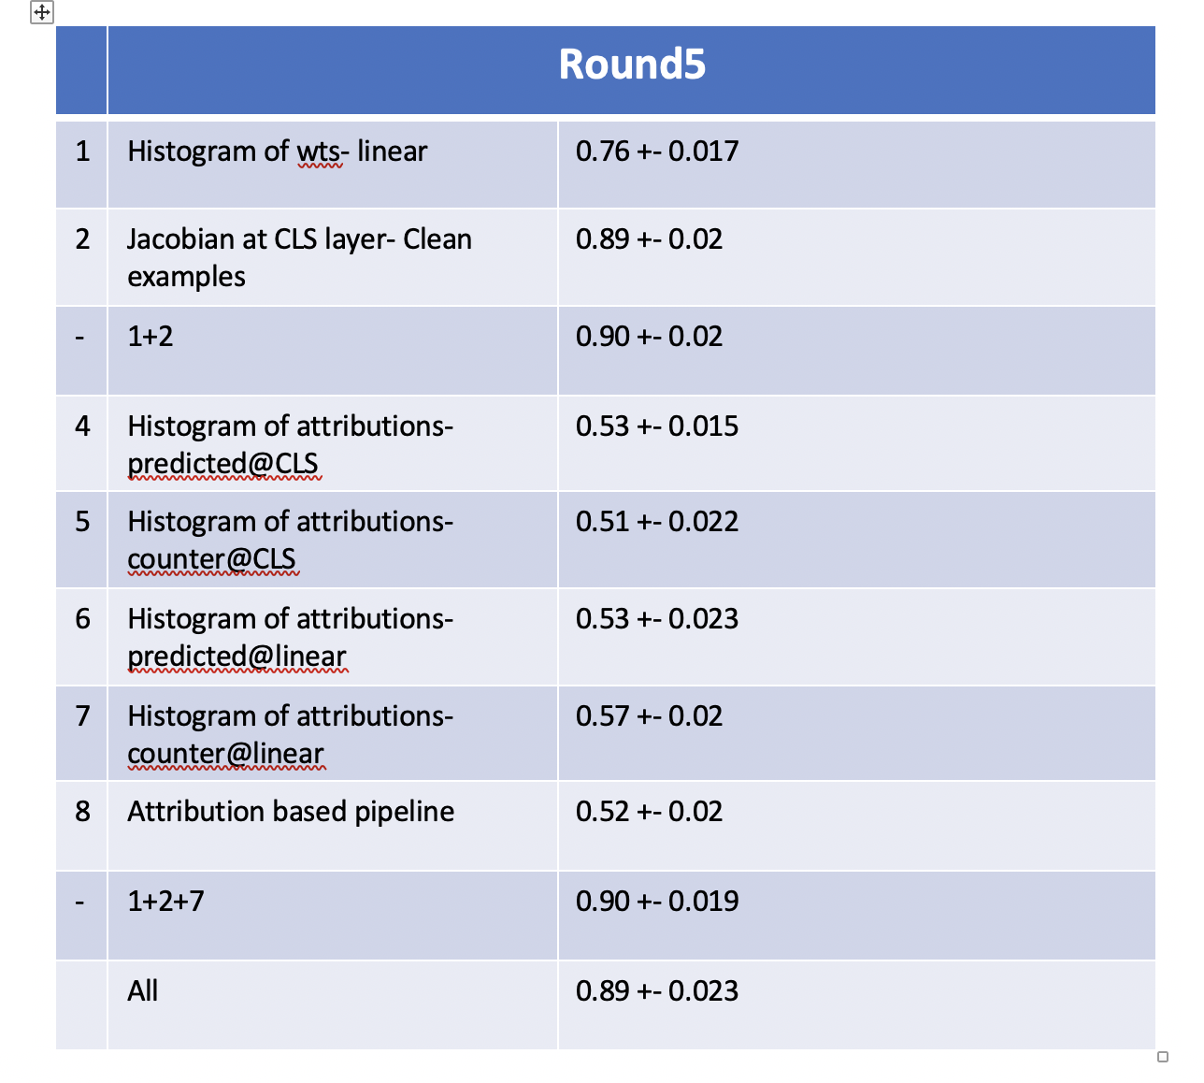
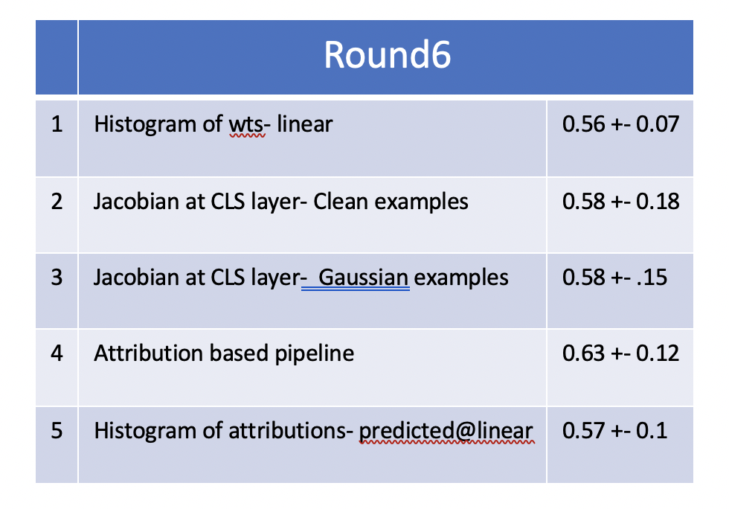
Trojan Detection with Sensitivity Analysis
Performance on Round5 and Round6 with different combinations of sensitivity-based features and attributions.

Slide 31
Trojan Detection with Sensitivity Analysis
Best performing features were Jacobian based features
Fusion helped a little
Large drop from Round5 to Round6 - less number of examples, and more generalized models
Adapted our vision based adversarial pipeline for NLP rounds as well where we were attacking features instead of input.

Slide 32
Trojan Detection with Adversarial Learning
Extended from the vision rounds
Attacked the embedded features (not the input) with a UAP attack with norm=1, eps=250, delta=0.4, max_iter=20.
The performance on 5 fold CV on Round5 was AUC=0.67. The performance on Round6 was lower (AUC=0.52).
Observed that simple methods (e.g. greedy) are too aggressive and often end up changing inputs with high positive or negative sentiments.

Slide 33
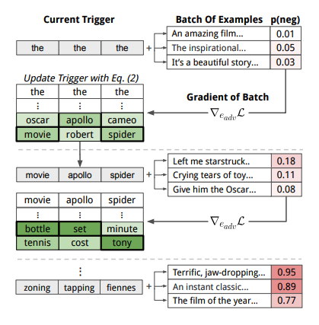
Universal Adversarial Attack Based Trigger Inversion
Adapted from Universal Adversarial Triggers for Attacking and Analyzing NLP” (https://arxiv.org/abs/1908.07125) to Round7 and Round8
Method based on HotFlip that generates example specific adversarial inputs
Above method extended HotFlip to synthesize a global trigger (like UAP) that would cause misclassification
Insight: Trojans are also universal in nature and thus we can adapt this work for trojan detection

Slide 34
Universal Adversarial Attack Based Trigger Inversion
Insert neutral tokens based on policy. Policy being global or local insertion in round 7 and start, end, random insertion in question or context in round 8.
Backprop to obtain the gradients to flip the classification label at the newly inserted neutral token
Cosine distance between the gradient and the embedding vector to score all tokens
Greedily select next token from the vocabulary. We found Beam search not helping as even in phrase triggers the tojans are usually activated with a perticular token in the phrase (usually the first or last word)

Slide 35
Universal Adversarial Attack Based Trigger Inversion
Non-Targeted implementation (Round - 7)
Initially tried it with flipping a random label but that did not work well. So instead made the method to work class-wise especially in presence of a background token
Most flips were occurring around the background classes and was also attacking benign models
Targeted implementation (Round - 7)
Inserted trigger flips classes in 1->1 manner. This helps to figure trojans where we can optimize with consistent source and destination
Try all possible (src -> dst) combinations N^2 flips (N=number of classes)
Record the lowest loss for each model --> Train shallow classifier
Time complexity O(N^2) -> Timed out on submission

Slide 36
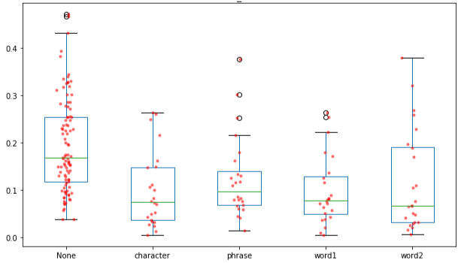
Universal Adversarial Attack Based Trigger Inversion
Targeted implementation (Round - 7) - Improved
Improved time complexity to O(N) (N=number of classes)
Start with a given src class, the optimization guides towards the best dst class to reduce the loss.
Better shallow classifier training/selection by symmetric train test splits across important dataset configurations.
Method | ROC-AUC | CE
global insertion policy | 0.715 | 0.659
global+local insertion policy | 0.721 | 0.525
global+local policy + classifier sel. | 0.800 | 0.597
Results from leaderboad submissions
min_loss distribution for different type of trojans.

Slide 37
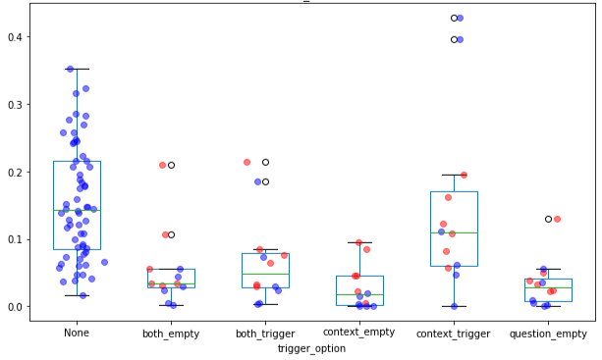
Universal Adversarial Attack Based Trigger Inversion
Targeted implementation (Round - 8)
Extented it to Question-Answering round.
Insertion policy - start, end, random insertion in question and/or context.
Shallow classifiers trained on lowest loss performs quiet well.
min_loss distribution for different type of trojans. The ‘red’ data points are phrased triggers models.
Results from leaderboad submissions

Slide 38
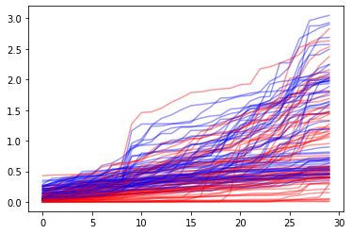
Universal Adversarial Attack Based Trigger Inversion
Targeted implementation (Round - 8)
Working to improve performance by using loss feature over several policy runs.
Loss is dependent on length of trigger in Round 8 and that hurts trigger inversion for phase triggerred models.
Working to optimize for adaptive length tigger inversion.
Method | ROC-AUC | CE
Empty trigger type + Classfier on min loss | 0.563 | 0.681
All trigger type + Classfier on min loss | 0.782 | 0.578
Classier on loss feature over several policy runs | 0.759 | 0.574
Results from leaderboad submissions
loss profile for different policy runs.
`red` is trojaned models and `blue` is benign models

Slide 39
Universal Adversarial Attack Based Trigger Inversion
Approach was amongst the top for Round7-8
Declare it a success as our basic idea was able to generalize easily to multiple rounds
Probably due to the discrete nature of inputs
Also experimented with using attention outputs (or attributions) to verify whether a trigger is real or not
Drawback
Often able to synthesize strong triggers for benign models
Lower performance for phrase triggers

Slide 40
Afterthoughts
Learned a lot during the program and thanks to the TrojaAI team
NIST made sure that data were very well structured, and it accelerated development
Trojan Detection is a hard problem
Difficult to find a universal solution
Solution changes based on DNN type and complexity of trojan
Solution might be more tractable when constraining the DNN type as in the case of NLP rounds
Explored two methods at different ends of the spectrum (bias-variance tradeoff)
Trigger inversion- requires domain knowledge and tweaking, tailored solution work better
Sensitivity analysis- more adaptable but performance is usually lower than the trigger inversion approach
Notes:
Hard problem
Solution might be there if we constrain the architecture or training process
How to remove a trojan if found a model

Slide 41
Afterthoughts
An interesting problem to explore is removal of trojan from a model
Will later present some slides on ongoing work on trojans in multimodal models
Notes:
Hard problem
Solution might be there if we constrain the architecture or training process
How to remove a trojan if found a model

